Slide 1

Ansible Bootcamp

Slide 2
Learning Goals
Explain what Ansible is (What)
Describe Ansible use cases (Why)
Identify use cases and describe the solutions Ansible provide (When)
Know the components of Ansible (How)

Slide 3
Ansible
Ansible is for :
  Application Deployment
  Multi-Tier Orchestration
  Configuration Management
Why Ansible ? Ansible is :
  Simple
  Easy to write, read, maintain and evolve- without writing scripts or custom code
  Fast to learn and set up

Slide 4
Ansible : Use Cases
Remote execution
Configuration Management
Deployment and Orchestration

Slide 5
Ansible: Remote Execution
Replacement for traditional systems administration tasks
Checking system responsiveness and uptime
Gathering information about a collection of systems
Replace one off rsync scripts, fabric, or terminal multiplexing

Slide 6
Ansible: Configuration Management
Lengthy, fine-grained system configuration,
  e.g. adding users, ssh keys, installing and configuring services, and bootstrapping systems to a given state.
"Configuration remediation" – ensure consistent server configuration.
  removes manual configuration errors
  Checks for ”Configuration Drift”
Version-controlled – service configurations can be reliably reproduced.

Slide 7
Ansible: Deployment and Orchestration
Separate physical infrastructure from tasks
Allow model-based description of services
Good for complex, interdependent service deployment

Slide 8
Aspects of Ansible
Simple connection model :
  No master-slave relationships
  Everything can configure everything (even self-configuration)
  No custom agent to set up
  Security provided by SSH
  Simplest mode is push from control node to controlled nodes

Slide 9
Vocabulary
Inventory:
  Hosts
  Groups
Execution:
  Tasks
  Plays
  Playbooks
Batteries:
  Modules
  Library

Slide 10
Vocabulary: Inventory
Hosts
  A remote machine that Ansible manages
  Can have individual variables (host name, connection port number, etc)
Groups
  Easy way to combine hosts with similar aspects
  All hosts in a group share group variables
Inventory
  Fill description of hosts which you own and control
  Can nest groups and move hosts in and out of groups

Slide 11
Vocabulary: Execution
Playbook
  How Ansible orchestrates, configures, administers or deployes systems
  A combined, coherent description of a complex state of applications, hosts, services.
Plays
  A mapping between a set of hosts and the tasks which run on those hosts
  defines the role that those systems will perform.
  There can be one or many plays in a playbook
Tasks: Application of a single module on the specified host(s)

Slide 12
Vocabulary: Batteries
Modules:
  units of work that Ansible ships out to remote machines.
  can be implemented in any language.
  Return JSON or simple key=value pairs.
  Once modules are executed on remote machines, they are removed, → no long running daemons used
Library:
  Collection of available modules

Slide 13
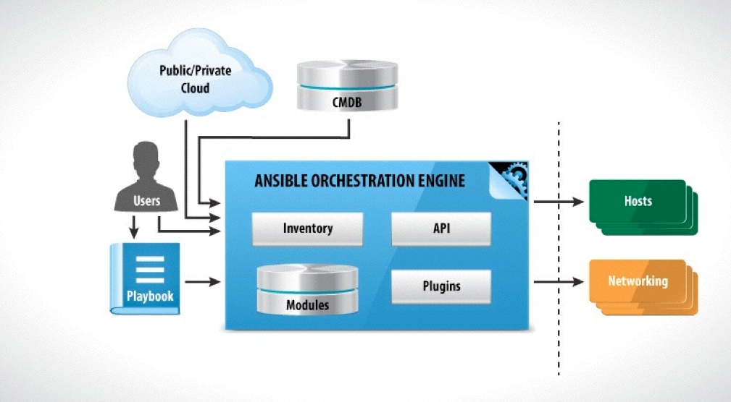
Architecture
http://slides.com/racku/ansible-fundamentals#/4/17

Slide 14
Not Covered Yet
Variables
Filters
Conditionals
Loops

Slide 15
Ansible: Footprint
Control machine:
  *NIX (no Windows yet)
  (Optional) SSH Client
  Python 2.6
  Since 2.0 dependencies are maintained with pip
Managed node:
  OpenSSH server
  > Python-2.4

Slide 16

Hands-on session
Install Ansible

Slide 17
Ansible Ad-Hoc
Create an inventory of localhost
Collect facts
Ensure that there is an Ansible user on the host
Ensure that ntpd is installed

